Slide 1
Muhammad Iylia Bin Mohd Hutta
P7474841

Slide 2
Datasets
Resale Flat Prices
HDB Resale Price Index
Number of Applications Registered for Resale Flats
Completion Status for HDB Developments
Bookings for New Flats

Slide 3
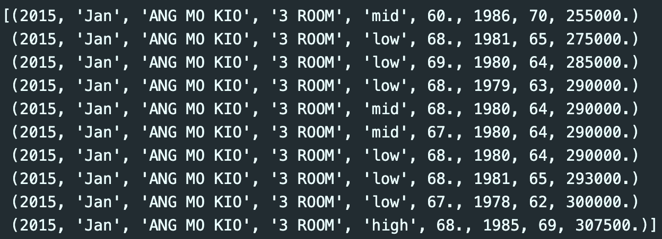
Resale Flat Prices
There are 180380 rows and 8 columns in this dataset
The names of the columns are:
year <class int64>
month <class <U50>
town <class <U50>
flat_type <class <U50>
storey_range <class <U50>
floor_area_sqm <class float64>
lease_commence_date <class int64>
remaining_lease <class int64>
resale_price <class float64>
Data transformation:
The dataset is a combination of data from the ‘2015 to 2016’ and ’2017 to present’ datasets
The ‘storey_range’ column was converted from numbered ranges to categorical levels of ‘low/mid/high’
The initial ‘month’ column obtained from data.gov.sg was split into the ‘year’ and ‘month’ columns

Slide 4
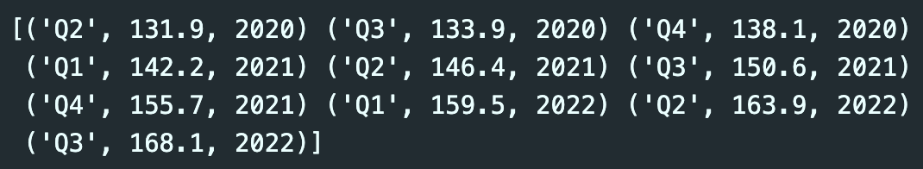
HDB Resale Price Index
There are 131 rows and 3 columns in this dataset
The names of the columns are:
quarter <class <U50>
index <class float64>
year <class int64>
The index calculates the average quarterly resale price while accounting for flat types, towns, and models.
Data transformation:
The initial ‘quarter’ column obtained from data.gov.sg was split into the ‘quarter’ and ‘year’ columns

Slide 5
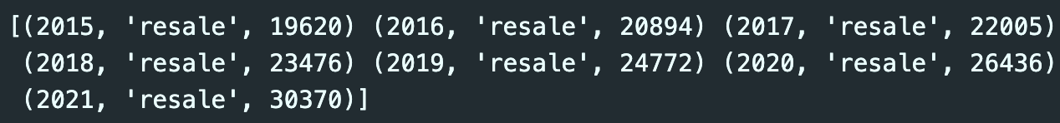
Number of Applications Registered for Resale Flats
There are 7 rows and 3 columns in this dataset
The names of the columns are:
year <class <int64>
type <class <U50>
applications_registered <class int64>
Data transformation:
The dataset was filtered for only resale flats and excluded for rental flats

Slide 6
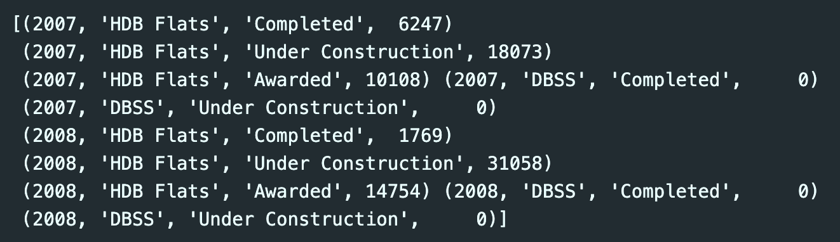
Completion Status of HDB Residential Developments
There are 75 rows and 4 columns in this dataset
The names of the columns are:
year <class int64>
type <class <U50>
status <class <U50>
no_of_units <class int64>
This dataset only includes new flats by HDB (incl. BTO, DBSS)
Data transformation:
The ‘no_of_units’ column had missing values indicated by ‘na’, which were filled with 0 values for ease of analysis

Slide 7
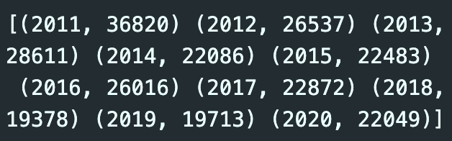
Bookings for New Flats
There are 11 rows and 2 columns in this dataset
The names of the columns are:
year <class <U50>
no_of_units <class int64>
This dataset only includes applications for new flats by HDB (incl. BTO, DBSS)

Slide 8
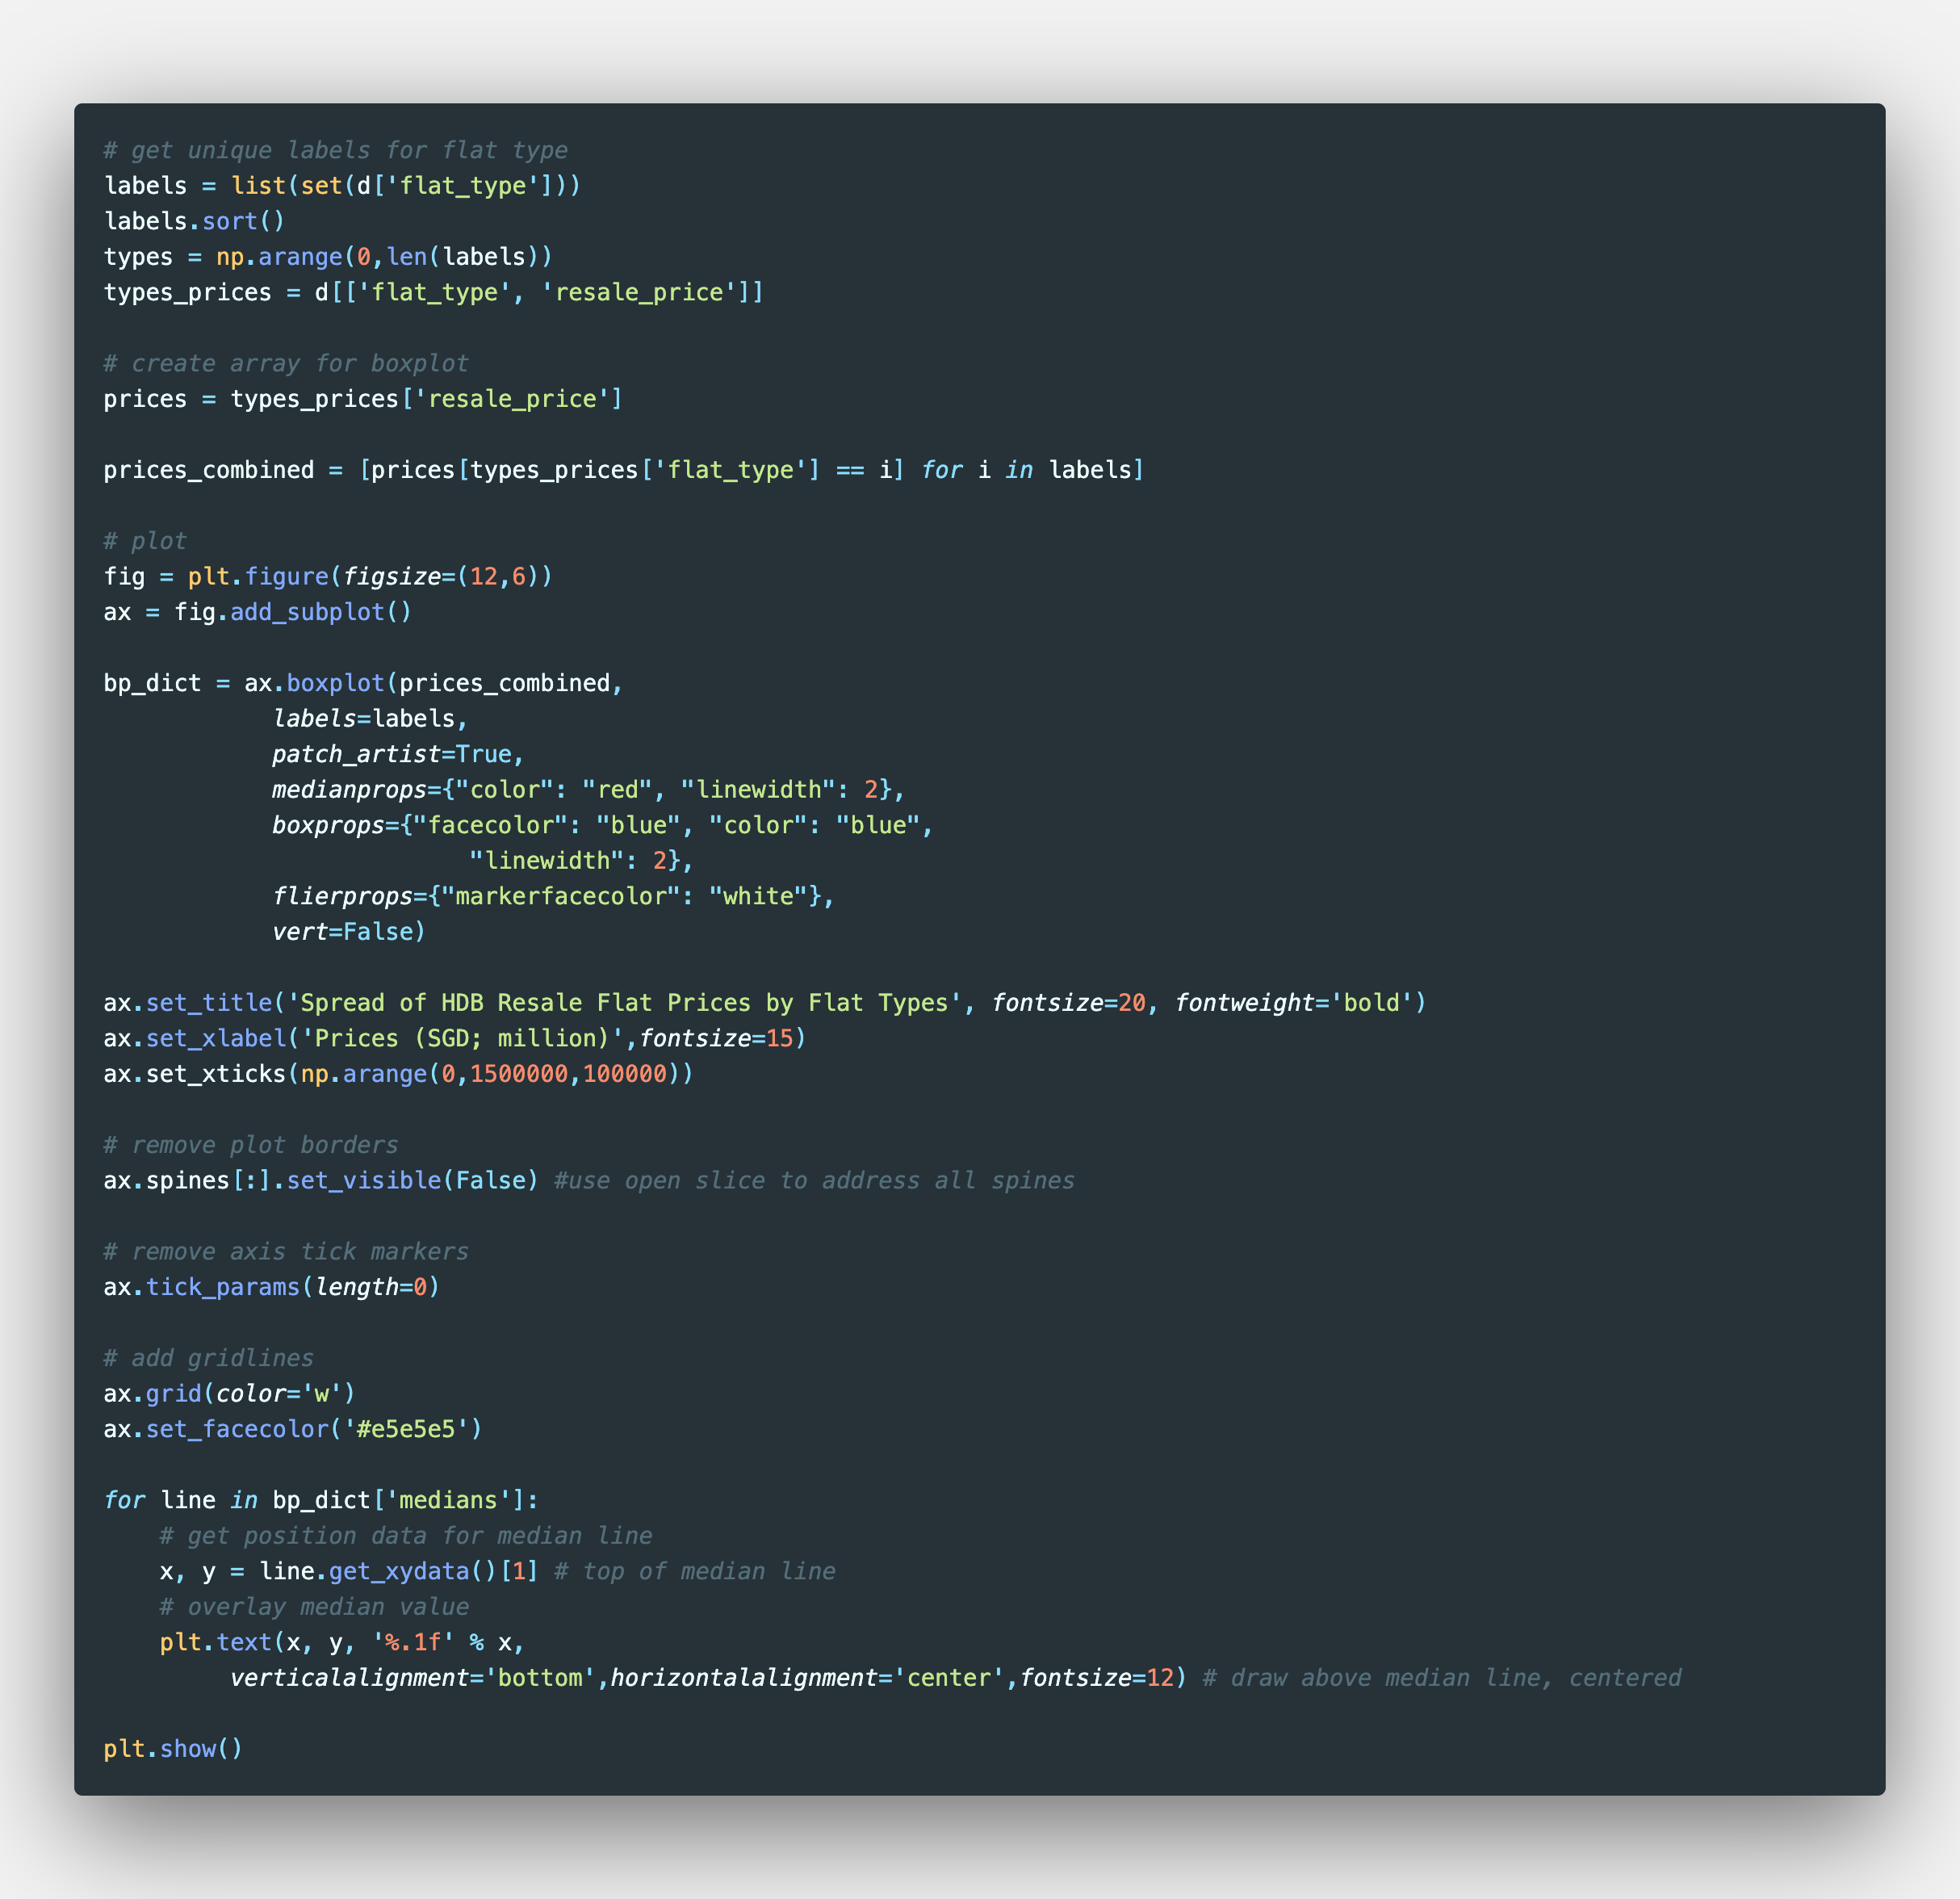
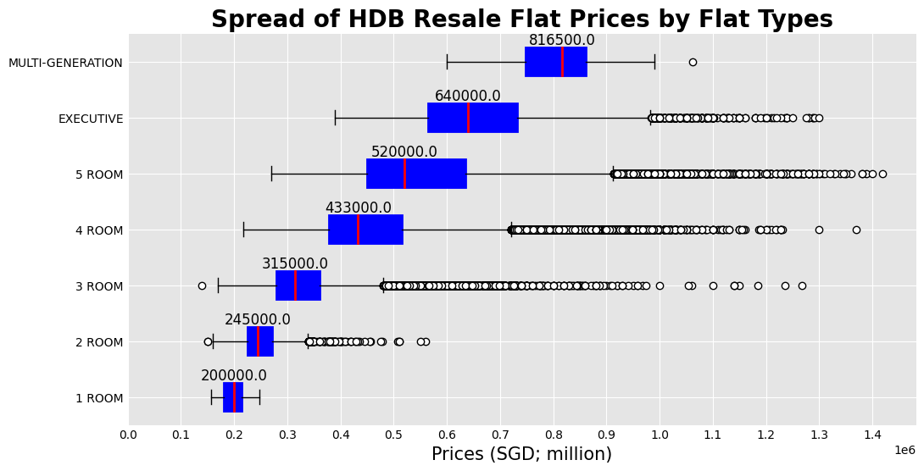
HDB Resale Flat Prices
Two lists were created for the Flat Type labels (‘labels’) and the range of prices for each flat type (‘prices_combined’)
Using the set() function and list comprehension respectively
The lists were used to create a boxplot of the spread of HDB Resale Flat Prices by Flat Types
Design and label attributes were added to the boxplot for better visualisation
Iylia Hutta

Slide 9
HDB Resale Flat Prices
As expected, the larger flat types see higher median prices than those of smaller types
Most flat types (except 1-room and Multi-Generation) are right-skewed with many outliers in the higher range of prices
The reason for skewness could be due to recent sales of resale flats hitting the price point of S$1m
Iylia Hutta

Slide 10
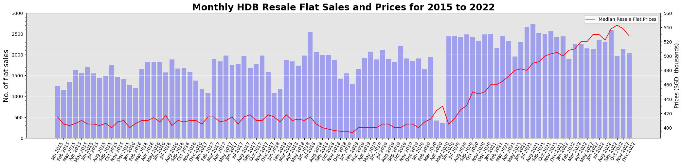

Slide 11
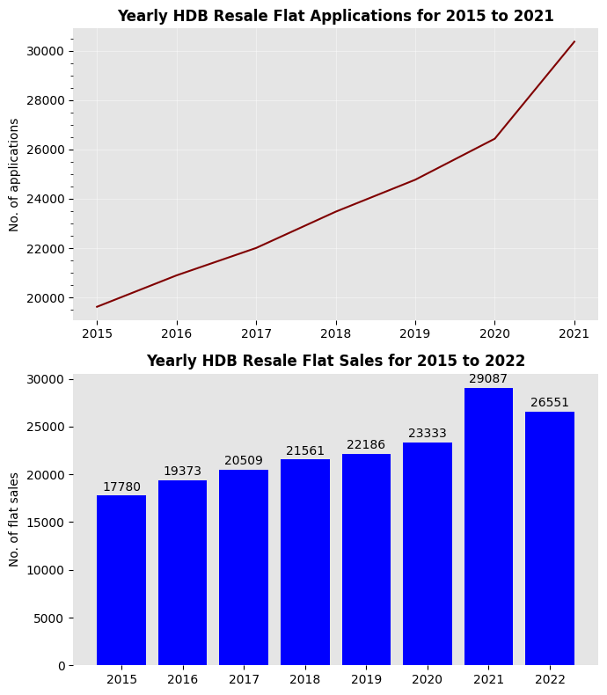

Slide 12
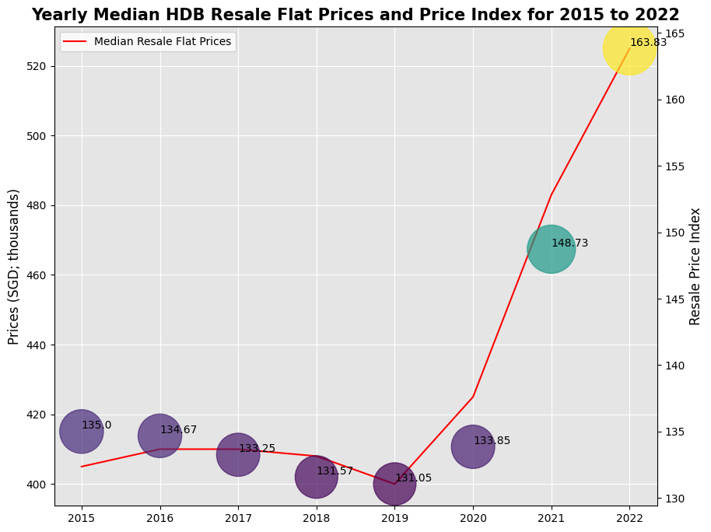

Slide 13
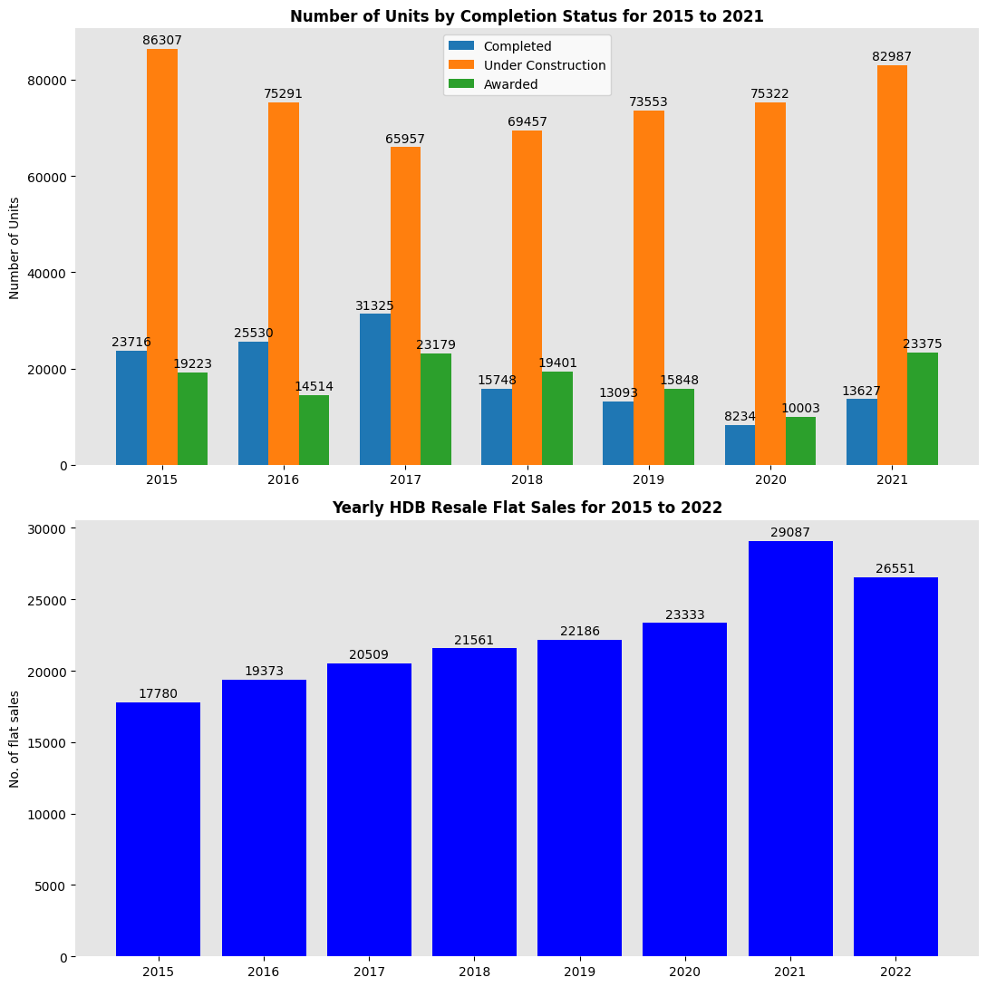

Slide 14
